Slide 1
Module 1
DWH Fundamentals

Slide 2
What is Data Warehouse?
A data warehouse is a large collection of business data used to help an organization make decisions.
It is a system used for reporting and data analysis and is considered a core component of business intelligence.
DWs are central repositories of integrated data from one or more disparate sources. They store current and historical data in one single place that are used for creating analytical reports for workers throughout the enterprise.
According to William H. Inmon, a leading architect in the construction of data warehouse systems, “A data warehouse is a subject-oriented, integrated, time-variant, and nonvolatile collection of data in support of management’s decision making process”
The four keywords—subject-oriented, integrated, time-variant, and
nonvolatile—distinguish data warehouses from other data repository systems, such as
relational database systems, transaction processing systems, and file systems.
*
Data Mining: Concepts and Techniques
‹#›

Slide 3
What is Data Warehouse?
A data warehouse is a large collection of business data used to help an organization make decisions.
A system used for reporting and data analysis ---a core component of business intelligence.
DWs are central repositories of integrated data from one or more disparate sources. They store current and historical data in one single place .
According to William H. Inmon, a leading architect in the construction of data warehouse systems, “A data warehouse is a subject-oriented, integrated, time-variant, and nonvolatile collection of data in support of management’s decision making process”
*
Data Mining: Concepts and Techniques
‹#›

Slide 4
Data warehouse characteristics
There are basic features that define the data in the data warehouse that include subject orientation, data integration, time-variant, nonvolatile data, and data granularity.
Subject-oriented: Unlike the operational systems, the data in the data warehouse revolves around the subjects of the enterprise. Subject orientation is not database normalization. Subject orientation can be really useful for decision-making. Gathering the required objects is called subject-oriented.
Integrated: The data found within the data warehouse is integrated. Since it comes from several operational systems, all inconsistencies must be removed. Consistencies include naming conventions, measurement of variables, encoding structures, physical attributes of data, and so forth.
Nonvolatile: The data in the data warehouse is read-only, which means it cannot be updated, created, or deleted (unless there is a regulatory or statutory obligation to do so).
Time-variant: While operational systems reflect current values as they support day-to-day operations, data warehouse data represents a long time horizon (up to 10 years) which means it stores mostly historical data. It is mainly meant for data mining and forecasting. (E.g. if a user is searching for a buying pattern of a specific customer, the user needs to look at data on his current and past purchases.)

Slide 5
Subject-oriented: A data warehouse is organized around major subjects such as customer, supplier, product, and sales.
Rather than concentrating on the day-to-day operations and transaction processing of an organization, a data warehouse focuses on the modeling and analysis of data for decision makers.
Hence, data warehouses typically provide a simple and concise view of particular subject issues by excluding data that are not useful in the decision support process.
Integrated: A data warehouse is usually constructed by integrating multiple heterogeneous sources, such as relational databases, flat files, and online transaction records.
Data cleaning and data integration techniques are applied to ensure consistency in naming conventions, encoding structures, attribute measures, and so on.

Slide 6
DWH Characteristics
Subject-oriented: A data warehouse is organized around major subjects .
A data warehouse focuses on the modeling and analysis of data for decision makers.
Hence, data warehouses typically provide a simple and concise view of particular subject issues .
Integrated: A data warehouse is usually constructed by integrating multiple heterogeneous sources, such as relational databases, flat files, and online transaction records.
Data cleaning and data integration techniques are applied to ensure consistency in naming conventions, encoding structures, attribute measures, and so on.

Slide 7
DWH Characteristics
Time-variant: Data are stored to provide information from an historic perspective (e.g., the past 5–10 years). Every key structure in the data warehouse contains, either implicitly or explicitly, a time element.
–Data in the DWH is mainly meant for data mining and forecasting.
Nonvolatile: The data in the data warehouse is read-only.

Slide 8
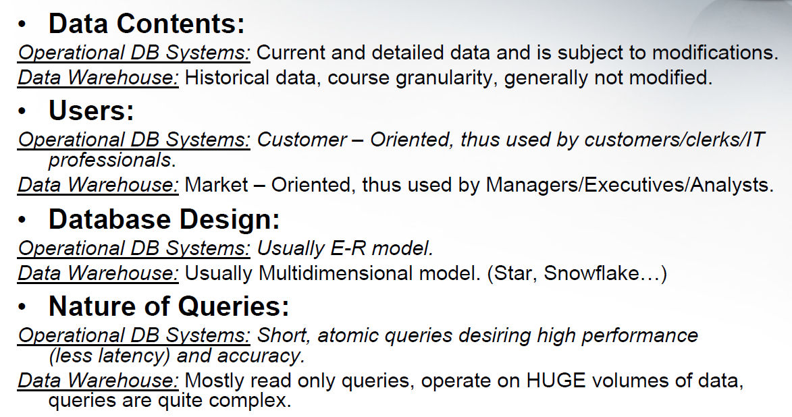
Operational DBS Vs. DWH

Slide 9
OLTP Vs OLAP
OLTP | OLAP
OLTP is an online transactional system. | OLAP is an online analysis and data retrieving process.
It is characterized by large numbers of short online transactions. | It is characterized by a large volume of data.
OLTP is an online database modifying system. | OLAP is an online database query management system.
OLTP uses traditional DBMS. | OLAP uses the data warehouse.
Insert, Update, and Delete information from the database. | Mostly select operations
OLTP and its transactions are the sources of data. | Different OLTP databases become the source of data for OLAP.
OLTP database must maintain data integrity constraints. | OLAP database does not get frequently modified. Hence, data integrity is not an issue.
It’s response time is in a millisecond. | Response time in seconds to minutes.
The data in the OLTP database is always detailed and organized. | The data in the OLAP process might not be organized.
Allow read/write operations. | Only read and rarely write.
It is a customer-oriented process. | It is a market oriented process.
Queries in this process are standardized and simple. | Complex queries involving aggregations.
Complete backup of the data combined with incremental backups. | OLAP only need a backup from time to time. Backup is not important compared to OLTP
DB design is an application-oriented example: Database design changes with the industry like retail, airline, banking, etc. | DB design is subject-oriented. Example: Database design changes with subjects like sales, marketing, purchasing, etc.

Slide 10
OLTP | OLAP
It is used by Data critical users like clerk, DBA & Data Base professionals. | It is used by Data knowledge users like workers, managers, and CEO.
It is designed for real time business operations. | It is designed for analysis of business measures by category and attributes.
Transaction throughput is the performance metric | Query throughput is the performance metric.
This kind of Database allows thousands of users. | This kind of Database allows only hundreds of users.
It helps to Increase user’s self-service and productivity | Help to Increase the productivity of business analysts.
It provides a fast result for daily used data. | It ensures that response to the query is quicker consistently.
It is easy to create and maintain. | It lets the user create a view with the help of a spreadsheet.

Slide 11
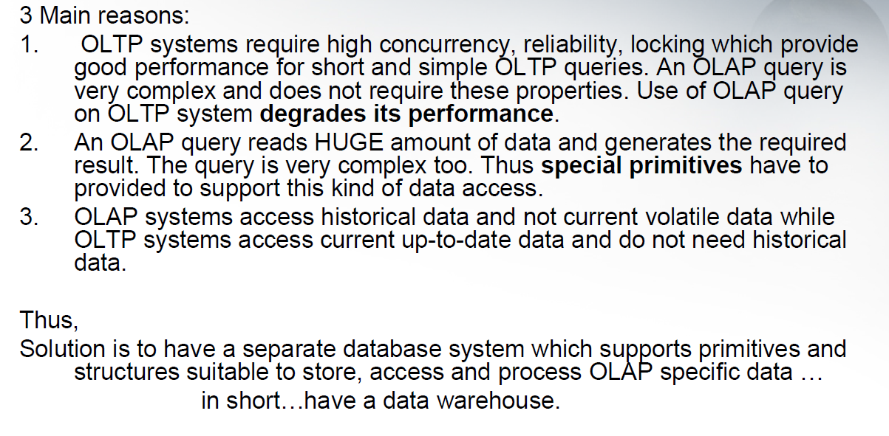
Why to have a separate Warehouse?

Slide 12
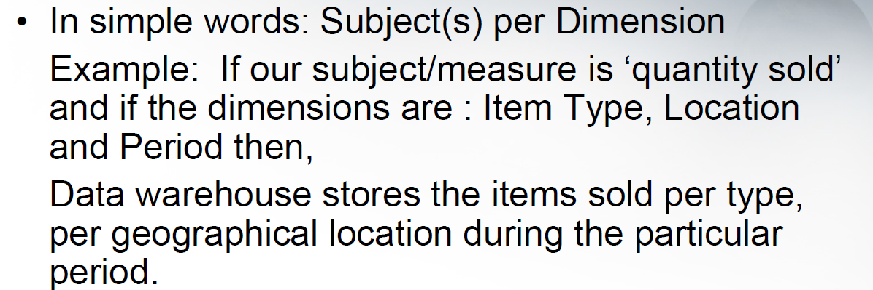
What data is stored in a DWH?

Slide 13
Data warehousing is the process of construction and using data warehouses.
The construction of a data warehouse requires data cleaning, data integration, and data consolidation.
The utilization of a data warehouse often necessitates a collection of decision support technologies.
This allows “knowledge workers” (e.g., managers, analysts, and executives) to use the warehouse to quickly and conveniently obtain an overview of the data, and to make sound decisions based on information in the warehouse.

Slide 14
“How are organizations using the information from data warehouses?”
Many organizations use this information to support business decision-making activities, including:
(1) increasing customer focus, which includes the analysis of customer buying patterns (such as buying preference, buying time, budget cycles, and appetites for spending);
(2) repositioning products and managing product portfolios by comparing the performance of sales by quarter, by year, and by geographic regions in order to fine-tune production strategies;
(3) analyzing operations and looking for sources of profit; and
(4) managing customer relationships, making environmental corrections, and managing the cost of corporate assets.

Slide 15
“How are organizations using the information from data warehouses?”
Many organizations use this information to support business decision-making activities, including:
(1) increasing customer focus, which includes the analysis of customer buying patterns ;
(2) repositioning products and managing product portfolios (by comparing the performance of sales by quarter, by year, and by geographic regions in order to fine-tune production strategies);
(3) analyzing operations and looking for sources of profit; and
(4) managing customer relationships, making environmental corrections, and managing the cost of corporate assets.

Slide 16
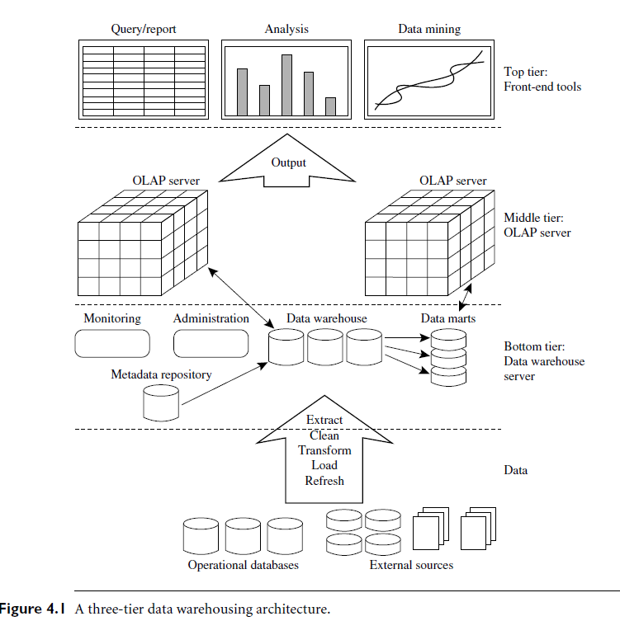
(RDBMS)
Gateways
Backend tools and utilities

Slide 17
Extraction, Transformation, and Loading
Data warehouse systems use back-end tools and utilities to populate and refresh their Data.These tools and utilities include the following functions:
Data extraction, which typically gathers data from multiple, heterogeneous, and
external sources.
Data cleaning, which detects errors in the data and rectifies them when possible.
Data transformation, which converts data from legacy or host format to warehouse
Format.
Load, which sorts, summarizes, consolidates, computes views, checks integrity, and
builds indices and partitions.
Refresh, which propagates the updates from the data sources to the warehouse.

Slide 18
Data Warehouse Models: Enterprise Warehouse, Data Mart, and Virtual Warehouse
Enterprise warehouse:
Collects information about subjects spanning the entire organization.
It provides corporate-wide data integration
It typically contains detailed data as well as summarized data.
An enterprise data warehouse may be implemented on traditional mainframes, computer superservers, or parallel architecture platforms.
It requires extensive business modeling and may take years to design and build

Slide 19
Data mart:
A data mart contains a subset of corporate-wide data that is of value to a specific group of users. The scope is confined to specific selected subjects.
The data contained in data marts tend to be summarized.
Data marts are usually implemented on low-cost departmental servers that are
Unix/Linux or Windows based.
The implementation cycle of a data mart is more likely to be measured in weeks rather than months or years. However, it may involve complex integration in the long run if its design and planning were not enterprise-wide.
Depending on the source of data, data marts can be categorized as independent or dependent.
—Independent data marts are sourced from data captured from one or more operational
systems or external information providers, or from data generated locally within a
particular department or geographic area.
—Dependent data marts are sourced directly from enterprise data warehouse

Slide 20
Virtual warehouse:
A virtual warehouse is a set of views over operational databases.
For efficient query processing, only some of the possible summary views may be materialized.
A virtual warehouse is easy to build but requires excess capacity on
operational database servers.

Slide 21
Types of Data Warehouse: 3 main types
Enterprise Data Warehouse (EDW):
A centralized warehouse.
It provides decision support service across the enterprise.
It offers a unified approach for organizing and representing data.
It also provide the ability to classify data according to the subject and give access according to those divisions.
Operational Data Store:
A data store required when neither Data warehouse nor OLTP systems support organizations reporting needs.
In ODS, Data warehouse is refreshed in real time.
Hence, it is widely preferred for routine activities
3. Data Mart:
A data mart is a subset of the data warehouse.
It is specially designed for a particular line of business, such as sales, finance.
In an independent data mart, data can be collected directly from sources.

Slide 22
How Data warehouse works?
The large amount of data in data warehouses comes from different places such as internal applications like marketing, sales, and finance; customer-facing apps; and external partner systems etc..
On a technical level, a data warehouse periodically pulls data from those apps and systems; then, the data goes through formatting and import processes to match with the data that is already in the warehouse. The data warehouse stores this processed data so that it is ready for decision makers to access.
How frequently data pulls occur, or how data is formatted, etc., will vary depending on the needs of the organization.

Slide 23
How Data warehouse works?
On a technical level, a data warehouse periodically pulls data from apps and systems;
Then, the data goes through formatting and import processes to match with the data that is already in the warehouse.
The data warehouse stores this processed data so that it is ready for decision makers to access.

Slide 24
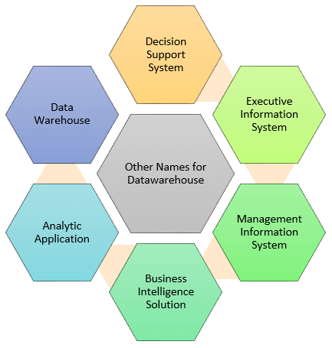

Slide 25
Who needs Data warehouse?
DWH (Data warehouse) is needed for all types of users like:
Decision makers who rely on mass amount of data
Users who use customized, complex processes to obtain information from multiple data sources.
It is also used by the people who want simple technology to access the data
It is also essential for those people who want a systematic approach for making decisions.
If the user wants fast performance on a huge amount of data which is a necessity for reports, grids or charts, then Data warehouse proves useful.
Data warehouse is a first step If you want to discover ‘hidden patterns’ of data-flows and groupings.

Slide 26
Advantages of Data Warehouse (DWH):
Data warehouse allows users to access critical data from the number of sources in a single place. Therefore, it saves user’s time of retrieving data from multiple sources.
Data warehouse provides consistent information on various cross-functional activities. It also supports ad-hoc reporting and query.
Data Warehouse helps to integrate many sources of data to reduce stress on the production system.
Data warehouse helps to reduce total turnaround time for analysis and reporting.
Restructuring and Integration make it easier for the user to use for reporting and analysis.
Data warehouse stores a large amount of historical data. This helps users to analyze different time periods and trends to make future predictions.

Slide 27
Parameter | Database | Data Warehouse
Purpose | Is designed to record | Is designed to analyze
Processing Method | The database uses the Online Transactional Processing (OLTP) | Data warehouse uses Online Analytical Processing (OLAP).
Usage | The database helps to perform fundamental operations for your business | Data warehouse allows you to analyze your business.
Tables and Joins | Tables and joins of a database are complex as they are normalized. | Table and joins are simple in a data warehouse because they are denormalized.
Orientation | Is an application-oriented collection of data | It is a subject-oriented collection of data
Storage limit | Generally limited to a single application | Stores data from any number of applications
Availability | Data is available real-time | Data is refreshed from source systems as and when needed
Usage | ER modeling techniques are used for designing. | Data modeling techniques are used for designing.
Technique | Capture data | Analyze data
Data Type | Data stored in the Database is up to date. | Current and Historical Data is stored in Data Warehouse. May not be up to date.
Storage of data | Flat Relational Approach method is used for data storage. | Data Warehouse uses dimensional and normalized approach for the data structure. Example: Star and snowflake schema.
Query Type | Simple transaction queries are used. | Complex queries are used for analysis purpose.
Data Summary | Detailed Data is stored in a database. | It stores highly summarized data.

Slide 28
Applications of Database
Sector | Usage
Banking | Used in the banking sector for customer information, account-related activities, payments, deposits, loans, credit cards, etc.
Airlines | Used for reservations and schedule information.
Universities | To store student information, course registrations, colleges, and results.
Telecommunication | It helps to store call records, monthly bills, balance maintenance, etc.
Finance | Helps you to store information related stock, sales, and purchases of stocks and bonds.
Sales & Production | Use for storing customer, product and sales details.
Manufacturing | It is used for the data management of the supply chain and for tracking production of items, inventories status.
HR Management | Detail about employee’s salaries, deduction, generation of paychecks, etc.

Slide 29
Applications of Data Warehousing
Sector | Usage
Airline | It is used for airline system management operations like crew assignment, analysis of route, frequent flyer program discount schemes for passenger, etc.
Banking | It is used in the banking sector to manage the resources available on the desk effectively.
Healthcare sector | Data warehouse used to strategize and predict outcomes, create patient’s treatment reports, etc. Advanced machine learning, big data enable data warehouse systems to predict illness.
Insurance sector | Data warehouses are widely used to analyze data patterns, customer trends, and to track market movements quickly.
Retain chain | It helps you to track items, identify the buying pattern of the customer, promotions and also used for determining pricing policy.
Telecommunication | In this sector, data warehouse is used for product promotions, sales decisions and to make distribution decisions.

Slide 30
Disadvantages of Database
Cost of Hardware and Software of an implementing Database system is high which can increase the budget of your organization.
Many DBMS systems are often complex systems, so the training for users to use the DBMS is required.
DBMS can’t perform sophisticated calculations
Issues regarding compatibility with systems which is already in place
Data owners may lose control over their data raising security, ownership, and privacy issues.

Slide 31
Disadvantages of Data Warehouse
Creation and Implementation of Data Warehouse is surely time confusing affair.
Data Warehouse can be outdated relatively quickly
Adding new data sources takes time, and it is associated with high cost.
Sometimes problems associated with the data warehouse may be undetected for many years.
Data warehouses are high maintenance systems. Extracting, loading, and cleaning data could be time-consuming.
The data warehouse may look simple, but actually, it is too complicated for the average users. You need to provide training to end-users, who end up not using the data mining and warehouse.
Despite best efforts at project management, the scope of data warehousing will always increase.

Slide 32
Metadata Repository
When used in a data warehouse, metadata are the data that define warehouse objects.
A metadata repository should contain the following:
A description of the data warehouse structure, which includes the warehouse schema, view, dimensions, hierarchies, and derived data definitions, as well as data mart locations and contents
Operational metadata, which include data lineage (history of migrated data and the
sequence of transformations applied to it), currency of data (active, archived, or
purged), and monitoring information (warehouse usage statistics, error reports, and
audit trails).
The algorithms used for summarization, which include measure and dimension definition algorithms, data on granularity, partitions, subject areas, aggregation, summarization, and predefined queries and reports.

Slide 33
Metadata Repository
Mapping from the operational environment to the data warehouse, which includes source databases and their contents, gateway descriptions, data partitions, data extraction, cleaning, transformation rules and defaults, data refresh and purging rules, and security (user authorization and access control).
Data related to system performance, which include indices and profiles that improve
data access and retrieval performance, in addition to rules for the timing and
scheduling of refresh, update, and replication cycles.
Business metadata, which include business terms and definitions, data ownership
information, and charging policies.

Slide 34
Data Warehouse Modeling: Data Cube and OLAP
Data warehouses and OLAP tools are based on a multidimensional data model.
This model views data in the form of a data cube.
A data cube allows data to be modeled and viewed in multiple dimensions. It is defined by dimensions and facts/measures.
Dimensions are the perspectives or entities with respect to which an organization wants to keep records.
Each dimension may have a table associated with it, called a dimension table, which further describes the dimension.
Dimension tables can be specified by users or experts, or automatically generated and adjusted based on data distributions

Slide 35
Data Warehouse Modeling: Data Cube and OLAP
A multidimensional data model is typically organized around a central theme, such as sales. This theme is represented by a fact table.
Facts are numeric measures.(quantities by which we want to analyze relationships between dimensions).
The fact table contains the names of the facts, or measures, as well as keys to each of the related dimension tables.

Slide 36
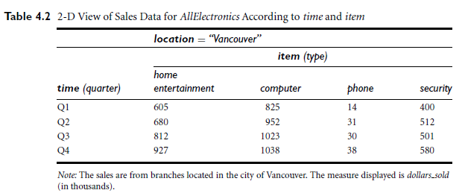
In data warehousing the data cube is n-dimensional.
Now, suppose that we would like to view the sales data according to time and item, as well as location, for the cities Chicago, New York, Toronto, and Vancouver.

Slide 37
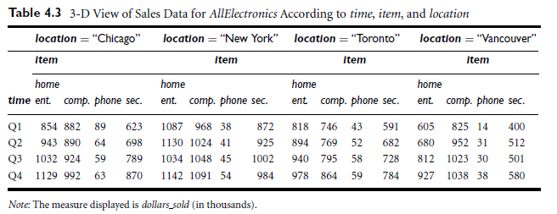
The 3-D data in the table are represented as a series of 2-D tables.

Slide 38
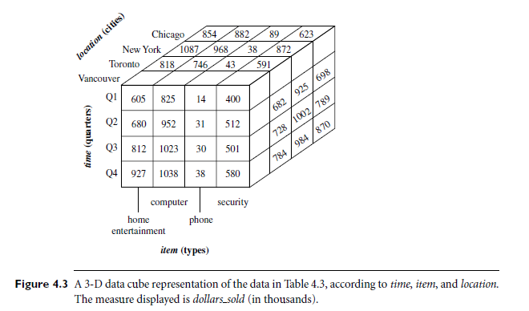
3-D data cube representation for the previous table data

Slide 39
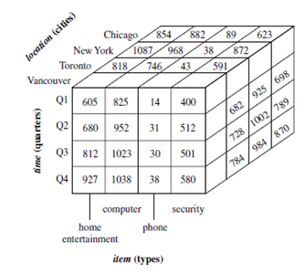

Slide 40
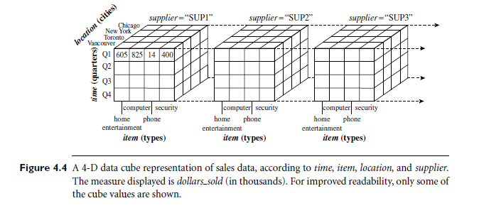
Now I want to view same data with additional 4th dimension as supplier
Here ,we can think of a 4-D cube as being a series of 3-D cubes as below:
If we continue in this way, we may display any n-dimensional data as a series of (n-1)-dimensional “cubes.”

Slide 41
The data cube is a metaphor for multidimensional data storage. The actual physical storage of such data may differ from its logical representation.
The important thing to remember is that data cubes are n-dimensional and do not confine data to 3-D.
Given a set of dimensions, we can generate a cuboid for each of the possible subsets of the given dimensions. The result would form a lattice of cuboids, each showing the data at a different level of summarization, or group-by.
The n-D cuboid that holds the lowest level of summarization is called the base cuboid(Least generalized i.e most specific).
The 0-D cuboid, which holds the highest level of summarization, is called the apex cuboid(Most generalized i.e least specific).

Slide 42
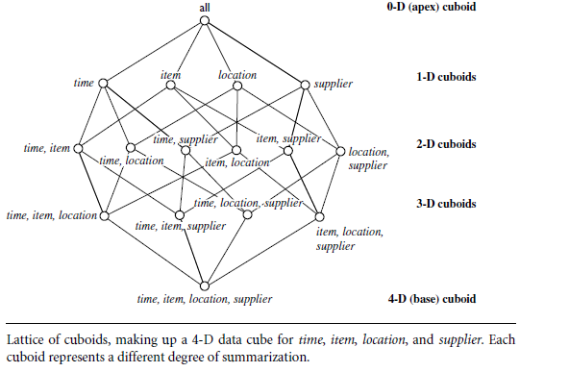
Lattice of Cuboids

Slide 43
Metadata Repository
When used in a data warehouse, metadata are the data that define warehouse objects.
A metadata repository should contain the following:
A description of the data warehouse structure, which includes the warehouse schema, view, dimensions, hierarchies, and derived data definitions, as well as data mart locations and contents
Operational metadata, which include data lineage (history of migrated data and the
sequence of transformations applied to it), currency of data (active, archived, or
purged), and monitoring information (warehouse usage statistics, error reports, and
audit trails).
The algorithms used for summarization, which include measure and dimension definition algorithms, data on granularity, partitions, subject areas, aggregation, summarization, and predefined queries and reports.

Slide 44
Metadata Repository
Mapping from the operational environment to the data warehouse, which includes source databases and their contents, gateway descriptions, data partitions, data extraction, cleaning, transformation rules and defaults, data refresh and purging rules, and security (user authorization and access control).
Data related to system performance, which include indices and profiles that improve
data access and retrieval performance, in addition to rules for the timing and
scheduling of refresh, update, and replication cycles.
Business metadata, which include business terms and definitions, data ownership
information, and charging policies.

Slide 45
Why Metadata is Important??
Metadata are used as a directory to help the decision support system analyst locate the contents of the data warehouse, and as a guide to the data mapping when data are transformed from the operational environment to the data warehouse environment.
Metadata also serve as a guide to the algorithms used for summarization between the current detailed data and the lightly summarized data, and between the lightly summarized data and the highly summarized data.
Metadata should be stored and managed persistently (i.e., on disk).

Slide 46
Dimensional Modelling
Dimensional Modeling (DM) is a logical design technique optimized for data storage in a Data warehouse.The purpose of dimensional modeling is to optimize the database for faster retrieval of data.
The concept of Dimensional Modelling consists of “fact” and “dimension” tables.
A dimensional model contains same information as ER model but packages the data in a symmetric format whose design goals are easy understandability, query performance, and resilience to change. Why ER is not suitable for DWH?
A dimensional model in data warehouse is designed to read, summarize, analyze numeric information like values, balances, counts, weights, etc. in a data warehouse.
In contrast, relation models are optimized for addition, updating and deletion of data in a real-time Online Transaction System.
Dimensional models are used in data warehouse systems and not a good fit for relational systems.
*
Data Mining: Concepts and Techniques
‹#›

Slide 47
Dimensional Modelling
ER modelling aims to optimize performance for transaction processing. It is also hard to query ER models because of the complexity; Therefore ER models are not suitable for high performance retrieval of data.
Data warehouse contain huge information. Data can't be fetched by normal technique so it requires special techniques.
Dimensional Modeling (DM) is a logical design technique optimized for data storage in a Data warehouse.The purpose of dimensional modeling is to optimize the database for faster retrieval of data.
A dimensional model contains same information as ER model but packages the data in a symmetric format whose design goals are easy understandability, query performance, and resilience to change.
A dimensional model in data warehouse is designed to read, summarize, analyze numeric information like values, balances, counts, weights, etc. in a data warehouse.
In contrast, relation models are optimized for addition, updating and deletion of data
in a real-time OLTP.
*
Data Mining: Concepts and Techniques
‹#›

Slide 48
Dimensional Modelling
ER models are not suitable for high performance retrieval of data.
Dimensional Modeling (DM) is a logical design technique optimized for data storage in a Data warehouse.
The purpose of dimensional modeling is to optimize the database for faster retrieval of data.
A dimensional model contains same information as ER model but packages the data in a symmetric format whose design goals are easy understandability, query performance, and resilience to change.
A dimensional model in data warehouse is designed to read, summarize, analyze numeric information (like values, balances, counts, weights, etc.) in a data warehouse.
In contrast, relation models are optimized for addition, updating and deletion of data
in a real-time OLTP.
*
Data Mining: Concepts and Techniques
‹#›

Slide 49
Elements of Dimensional Modelling
Fact
Facts are the measurements/metrics from your business process.
—For a Sales business process, a measurement would be quarterly sales number
Dimension
A category of information. For example, the time dimension.
In simple terms, they give who, what, where of a fact.
–E.g.In the Sales business process, for the fact quarterly sales number, dimensions would be
Who - Customer Names
Where - Location
What - Product Name
When - Time Dimension
In other words, a dimension is a window to view information in the facts.
AttributesThe Attributes are the various characteristics of the dimension
—E.g. In the Location dimension, the attributes can be State, Country , Zipcode etc.
Attributes are used to search, filter, or classify facts. Dimension Tables contain Attributes.
*
Data Mining: Concepts and Techniques
‹#›

Slide 50
Elements of Dimensional Modelling
Fact Table
A fact table is a primary table in dimension modelling.
Fact table consists of the measurements, metrics or facts of a business process.
Eg. Monthly sales volume, Average Customer Balance etc...
A Fact Table contains
1. Measurements/facts
2. Foreign key to dimension table
Dimension Table
A dimension table contains dimensions of a fact.
They are joined to fact table via a foreign key.
Dimension tables are denormalized tables.
The Dimension Attributes are the various columns in a dimension table
Dimensions offers descriptive characteristics of the facts with the help of their attributes
No limit set for number of dimensions
The dimension can also contain one or more hierarchical relationships

Slide 51
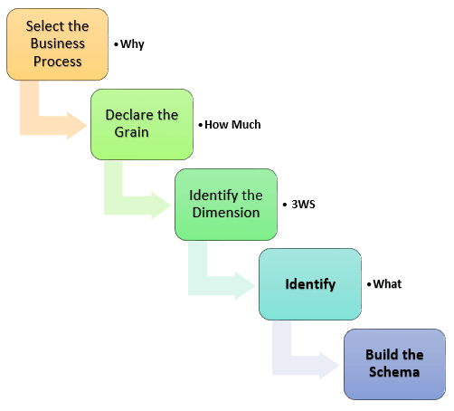
Steps of Dimensional Modelling
Identifying the actual business process a data warehouse should cover.
1. Do we need to store all the available products or just a few types of products? This decision is based on the business processes selected for DWH
2. Do we store the product sale information on a monthly, weekly, daily or hourly basis? This decision depends on the nature of reports requested by executives
3. How do the above two choices affect the database size?
When, Where, Who
Fact

Slide 52
Benefits of Dimensional Modeling
Standardization of dimensions allows easy reporting across areas of the business.
Dimension tables store the history of the dimensional information.
It allows to introduce entirely new dimension without major disruptions to the fact table.
Dimensional models also store data in such a fashion that it is easier to retrieve the information from the data once the data is stored in the database.
Compared to the normalized model dimensional table are easier to understand.
Information is grouped into clear and simple business categories.
The dimensional model is very understandable by the business. This model is based on business terms, so that the business knows what each fact, dimension, or attribute means.
Dimensional models are deformalized and optimized for fast data querying. Many relational database platforms recognize this model and optimize query execution plans to aid in performance.
Dimensional modelling in data warehouse creates a schema which is optimized for high performance. It means fewer joins and helps with minimized data redundancy.
The dimensional model also helps to boost query performance. It is more denormalized therefore it is optimized for querying.
Dimensional models can comfortably accommodate change. Dimension tables can have more columns added to them without affecting existing business intelligence applications using these tables.

Slide 53
Types of DWH Schema
Star Schema
Snowflake Schema
The star schema and snowflake schema are two different ways of organizing data warehouses.
Both schemas use dimension tables that describe the information contained within a fact table

Slide 54
Star Schema
In the star schema design, the fact table sits in the middle and is connected to dimension lookup tables like a star.
Each dimension is represented as a single table.
The primary key in each dimension table is related to a foreign key in the fact table.
All measures in the fact table are related to all the dimensions that fact table is related to. In other words, they all have the same level of granularity.
A star schema can be simple or complex. A simple star consists of one fact table; a complex star can have more than one fact table

Slide 55
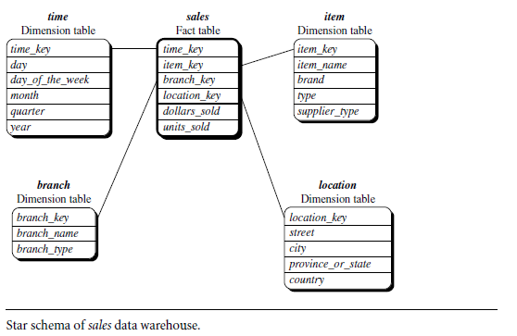
A star schema for AllElectronics sales is shown in Figure .
Sales are considered along four dimensions: time, item, branch, and location.
The schema contains a central fact table for sales that contains keys to each of the four dimensions, along with two measures: dollars sold and units sold.
To minimize the size of the fact table,dimension identifiers (e.g., time key and item key) are system-generated identifiers.

Slide 56
Characteristics of Star Schema
Every dimension in a star schema is represented with the only one-dimension table.
The dimension table should contain the set of attributes.
The dimension table is joined to the fact table using a foreign key
The dimension tables are not joined to each other
Fact table would contain keys and measures
The Star schema is easy to understand and provides optimal disk usage.
The dimension tables are not normalized.
The schema is widely supported by BI Tools

Slide 57
Snowflake Schema
The snowflake schema is an extension of the star schema which have multiple levels of dimension tables.
Snowflaking a dimension means normalizing it and making it more manageable by reducing its size.
Dimension tables are normalized which splits data into additional tables.
–Adv: This reduces redundancies.Such a table is easy to maintain and saves storage space.
–Disadv: Normalizing creates more dimension tables with multiple joins and reduces data integrity issues. However, querying is more challenging using the snowflake schema, because queries need to dig deeper to access the relevant data.
Also the snowflake structure can reduce the effectiveness of browsing, since more joins will be needed to execute a query. Consequently, the system performance may be adversely impacted.
Hence, although the snowflake schema reduces redundancy, it is not as popular as the star schema in data warehouse design.

Slide 58
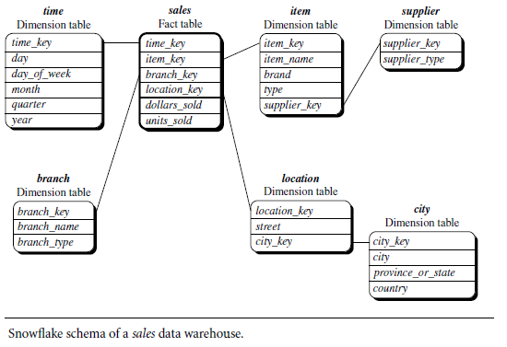

Slide 60
Characteristics of Snowflake Schema:
The main benefit of the snowflake schema it uses smaller disk space.
Easier to implement when a dimension is added to the Schema
Due to multiple tables query performance is reduced
The primary challenge that you will face while using the snowflake Schema is that you need to perform more maintenance efforts because of the more lookup tables.

Slide 61
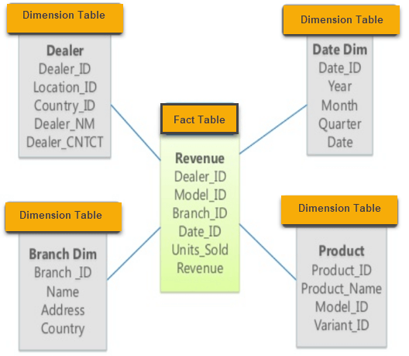
Star Schema

Slide 62
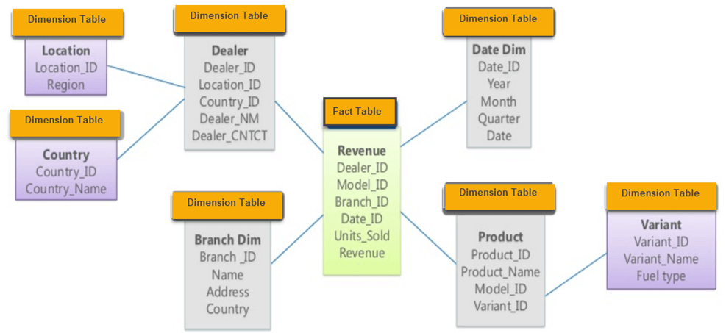
Country is further normalized into an individual table
Snowflake Schema

Slide 63
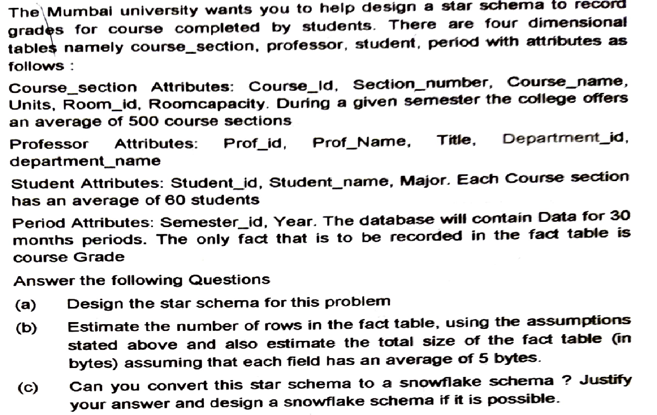

Slide 64
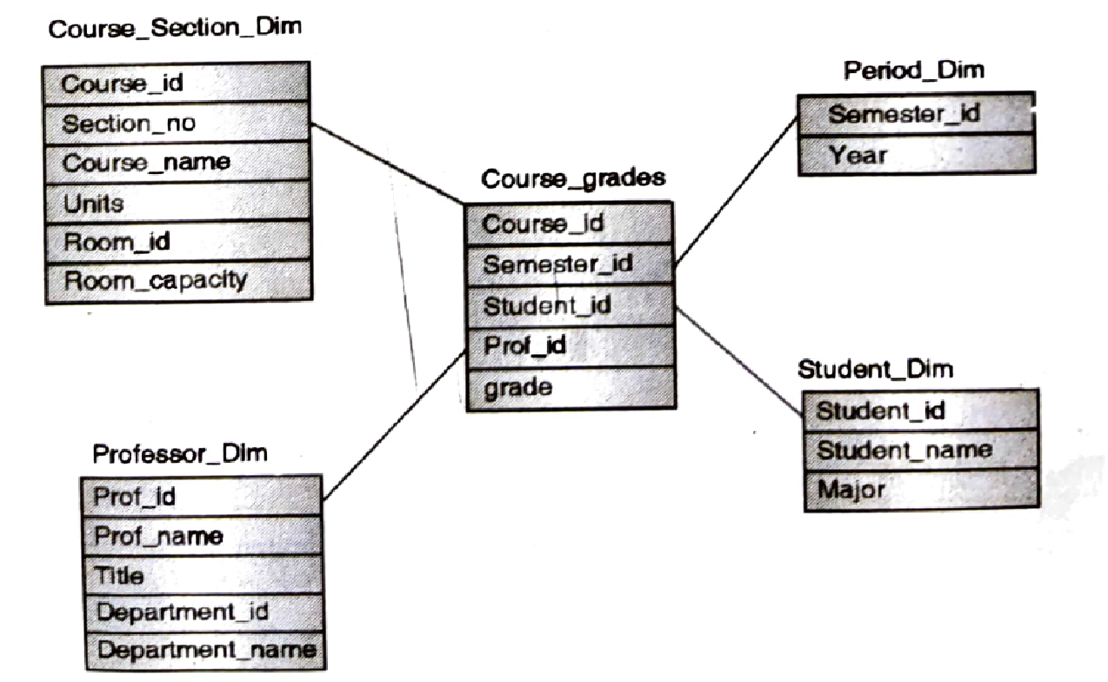
Star Schema

Slide 65
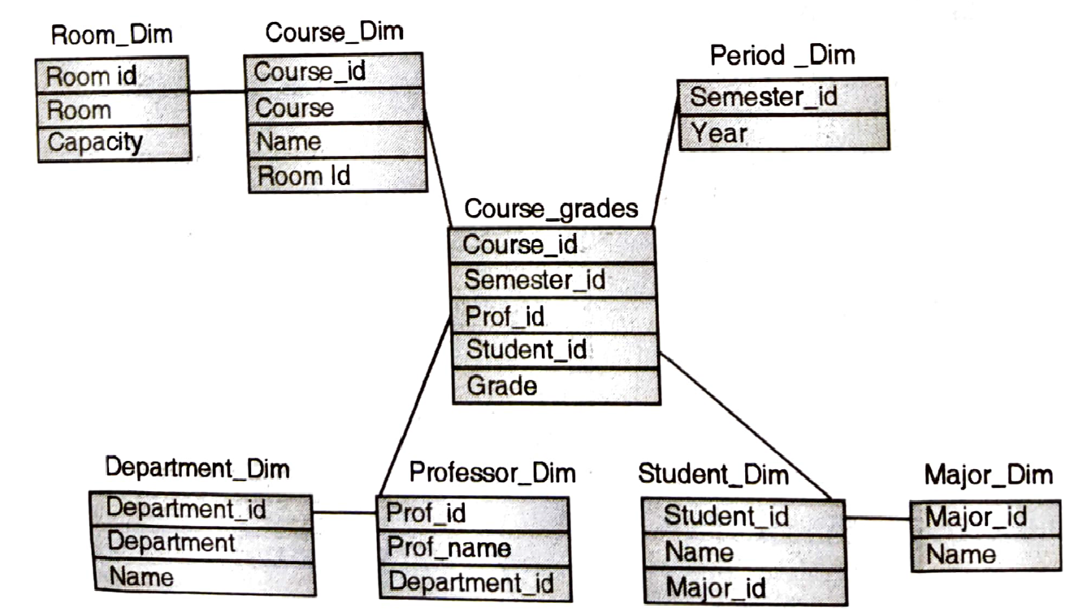
Snowflake Schema

Slide 66
Star Vs Snowflake Schema
Star Schema | Snowflake Schema
Hierarchies for the dimensions are stored in the dimensional table. | Hierarchies are divided into separate tables.
It contains a fact table surrounded by dimension tables. | One fact table surrounded by dimension table which are in turn surrounded by dimension table
In a star schema, only single join creates the relationship between the fact table and any dimension tables. | A snowflake schema requires many joins to fetch the data.
Simple DB Design. | Very Complex DB Design.
Denormalized Data structure and query also run faster. | Normalized Data Structure.
High level of Data redundancy | Very low-level data redundancy
Single Dimension table contains aggregated data. | Data Split into different Dimension Tables.
Cube processing is faster. | Cube processing might be slow because of the complex join.
Offers higher performing queries using Star Join Query Optimization. Tables may be connected with multiple dimensions. | The Snowflake schema is represented by centralized fact table which is unlikely connected with multiple dimensions.

Slide 67
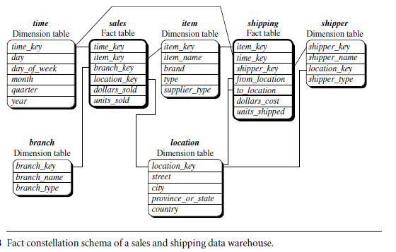
Fact constellation: Sophisticated applications may require multiple fact tables to share
dimension tables. This kind of schema can be viewed as a collection of stars, and
hence is called a galaxy schema or a fact constellation.
A fact constellation schema allows dimension tables to be shared between fact tables. For example, the dimensions tables for time, item, and location are shared between the sales and shipping fact tables.

Slide 68
In data warehousing, there is a distinction between a data warehouse and a data mart.
A data warehouse collects information about subjects that span the entire organization,such as customers, items, sales, assets, and personnel, and thus its scope is enterprise-wide.
For data warehouses, the fact constellation schema is commonly used, since it can model multiple, interrelated subjects. A data mart, on the other hand, is a department subset of the data warehouse that focuses on selected subjects, and thus its scope is departmentwide.
For data marts, the star or snowflake schema is commonly used, since both are geared toward modeling single subjects, although the star schema is more popular and efficient.

Slide 69
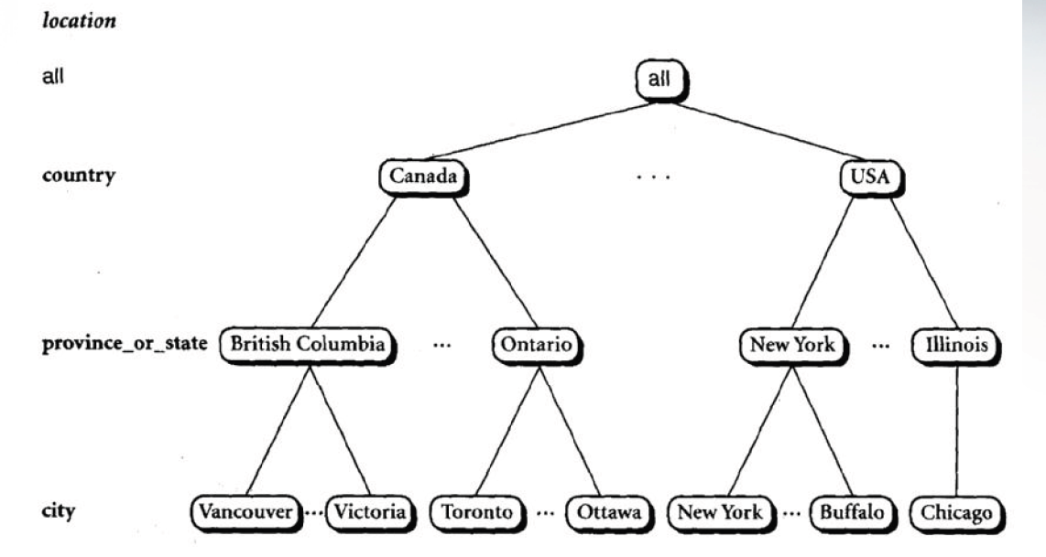
Concept Hierarchy

Slide 70
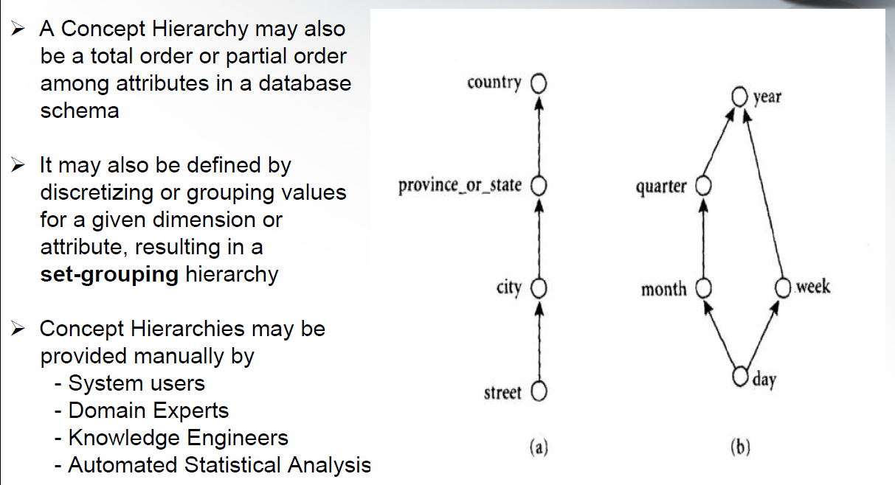
Concept Hierarchy

Slide 71
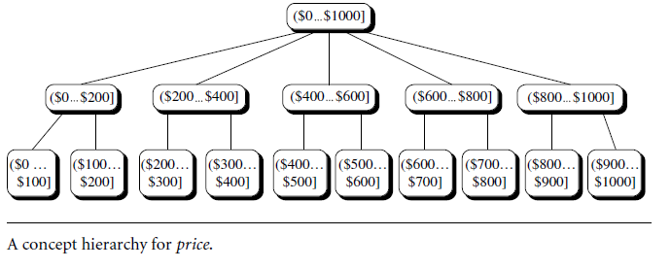
Set Grouping Hierarchy Example

Slide 72
Basic Analytical Operations of OLAP for multidimensional data
In the multidimensional model, data are organized into multiple dimensions, and each dimension contains multiple levels of abstraction defined by concept hierarchies.
Thus organization provides users with the flexibility to view data from different perspectives.
A number of OLAP data cube operations exist to materialize these different views, allowing interactive querying and analysis of the data at hand.
Hence, OLAP provides a user-friendly environment for interactive data analysis.
Roll-up
Drill-down
Slice and dice
Pivot(rotate)

Slide 73
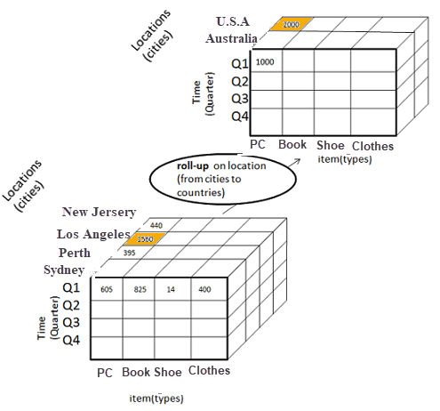
Basic Analytical Operations of OLAP
Roll-up :
Roll-up is also known as “consolidation” or “aggregation.” The Roll-up operation can be performed in 2 ways
Reducing dimensions
Climbing up concept hierarchy.
In the roll-up process at least one or more dimensions need to be removed.
In this example, cities New jersey and Los Angels are rolled up into country USA
The sales figure of New Jersey and Los Angels are 440 and 1560 respectively. They become 2000 after roll-up
In this aggregation process, data in location hierarchy moves up from city to the country.
In this example, Cities dimension is removed.

Slide 74
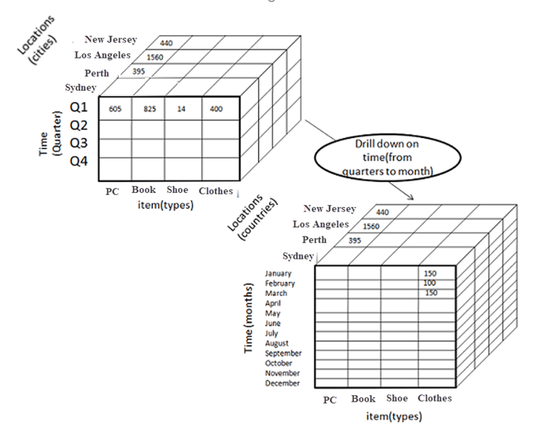
Basic Analytical Operations of OLAP
2. Drill-down
In drill-down, data is fragmented into smaller parts. It is the opposite of the rollup process. It can be done via
Moving down the concept hierarchy
Increasing a dimension
In this Example,
Quarter Q1 is drilled down to months
Here dimension Months is added.

Slide 75
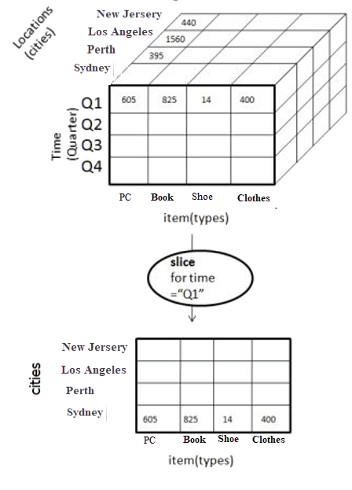
Basic Analytical Operations of OLAP
3. Slice
Here, one dimension is selected, and a new sub-cube is created.
In this Example,
Dimension Time is sliced with Q1 as the filter.
A new cube is created altogether.

Slide 76
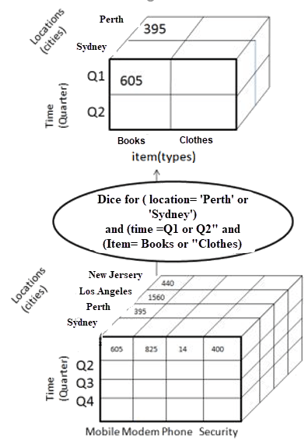
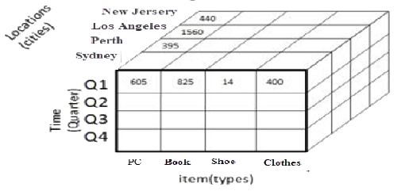
Basic Analytical Operations of OLAP
4. Dice
This operation is similar to a slice. The difference in dice is you select 2 or more dimensions that result in the creation of a sub-cube.
825
420
Dice operation in OLAP

Slide 77
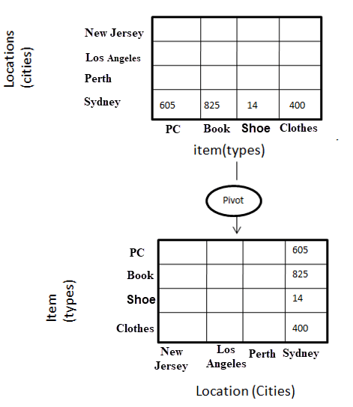
Basic Analytical Operations of OLAP
5. Pivot
In Pivot, you rotate the data axes to provide a substitute presentation of data.
Pivot operation in OLAP
Here the pivot is based on item types

Slide 78
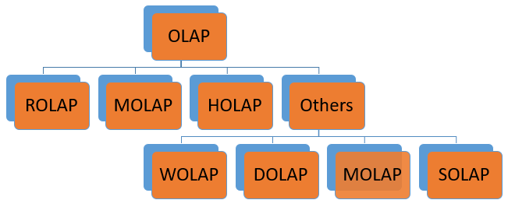
Types of OLAP systems
Type of OLAP | Explanation
Relational OLAP(ROLAP): | ROLAP is an extended RDBMS along with multidimensional data mapping to perform the standard relational operation.
Multidimensional OLAP (MOLAP) | MOLAP Implementes operation in multidimensional data.
Hybrid OnlineAnalytical Processing (HOLAP) | In HOLAP approach the aggregated totals are stored in a multidimensional database while the detailed data is stored in the relational database. This offers both data efficiency of the ROLAP model and the performance of the MOLAP model.
Desktop OLAP (DOLAP) | In Desktop OLAP, a user downloads a part of the data from the database locally, or on their desktop and analyze it. DOLAP is relatively cheaper to deploy as it offers very few functionalities compares to other OLAP systems.
Web OLAP (WOLAP) | Web OLAP which is OLAP system accessible via the web browser. WOLAP is a three-tiered architecture. It consists of three components: client, middleware, and a database server.
Mobile OLAP: | Mobile OLAP helps users to access and analyze OLAP data using their mobile devices
Spatial OLAP : | SOLAP is created to facilitate management of both spatial and non-spatial data in a Geographic Information system (GIS)

Slide 79
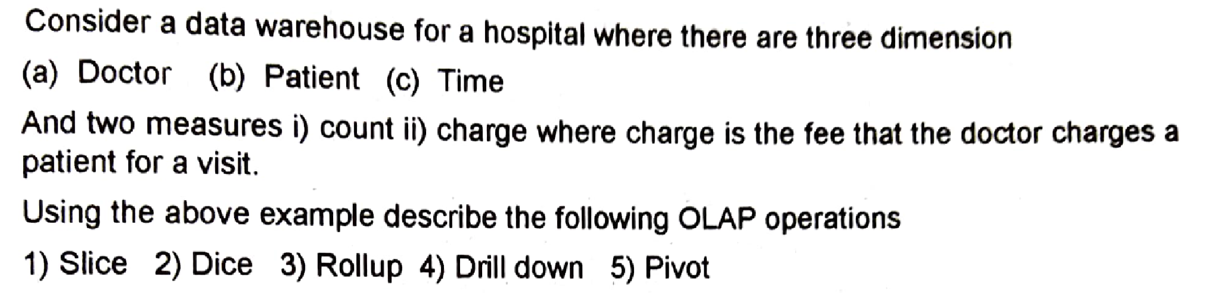
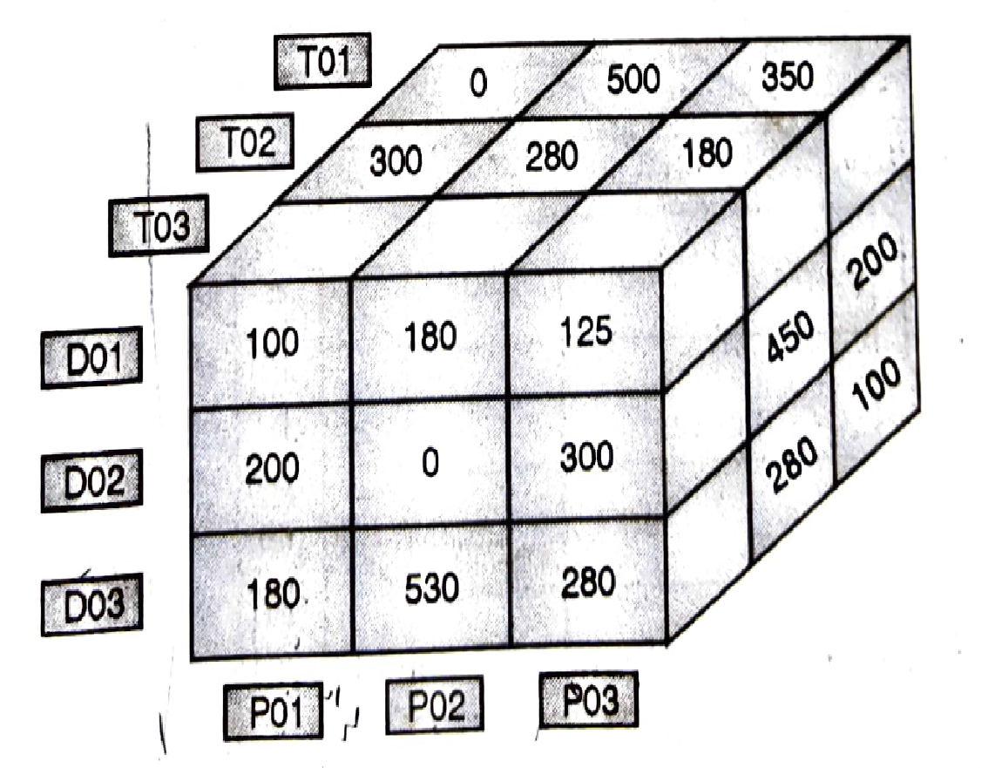
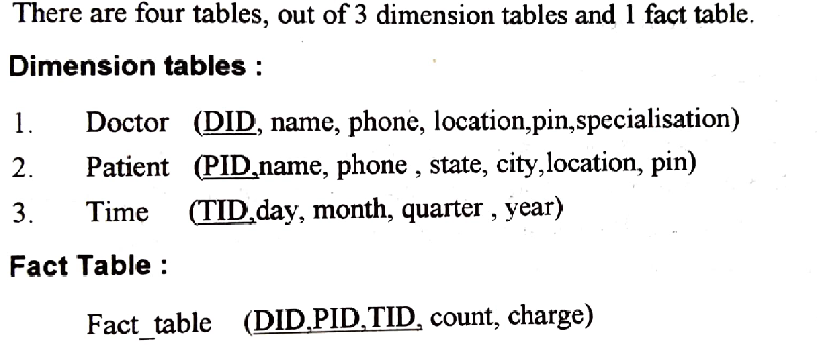

Slide 80
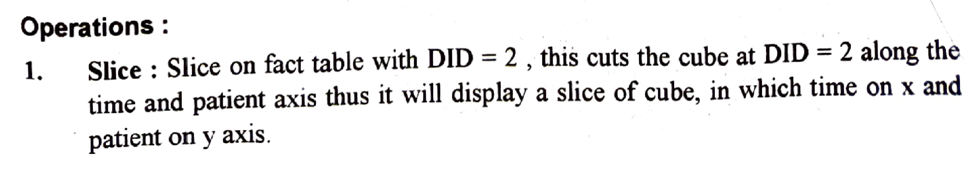
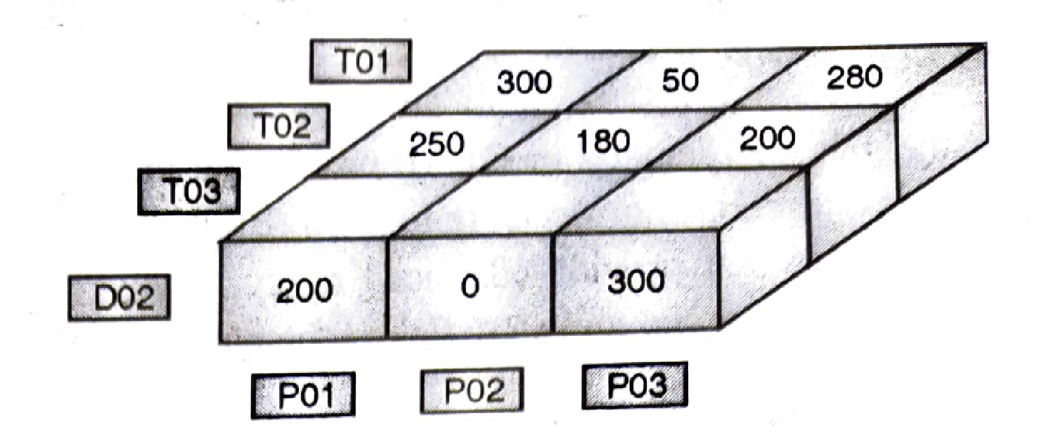

Slide 81
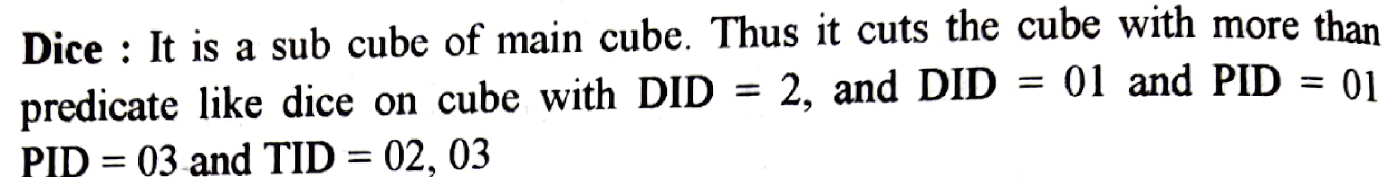
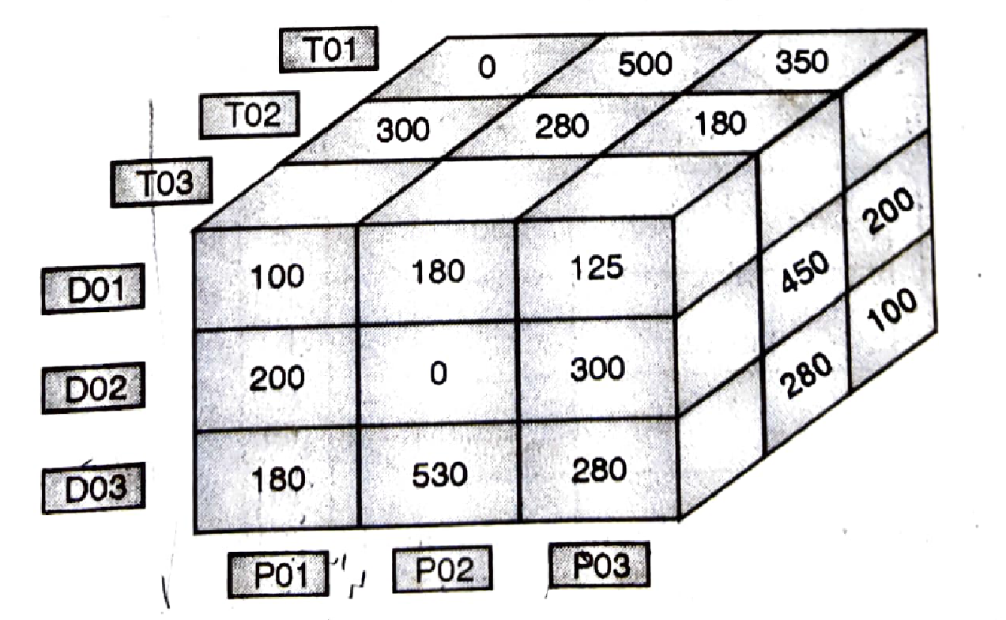
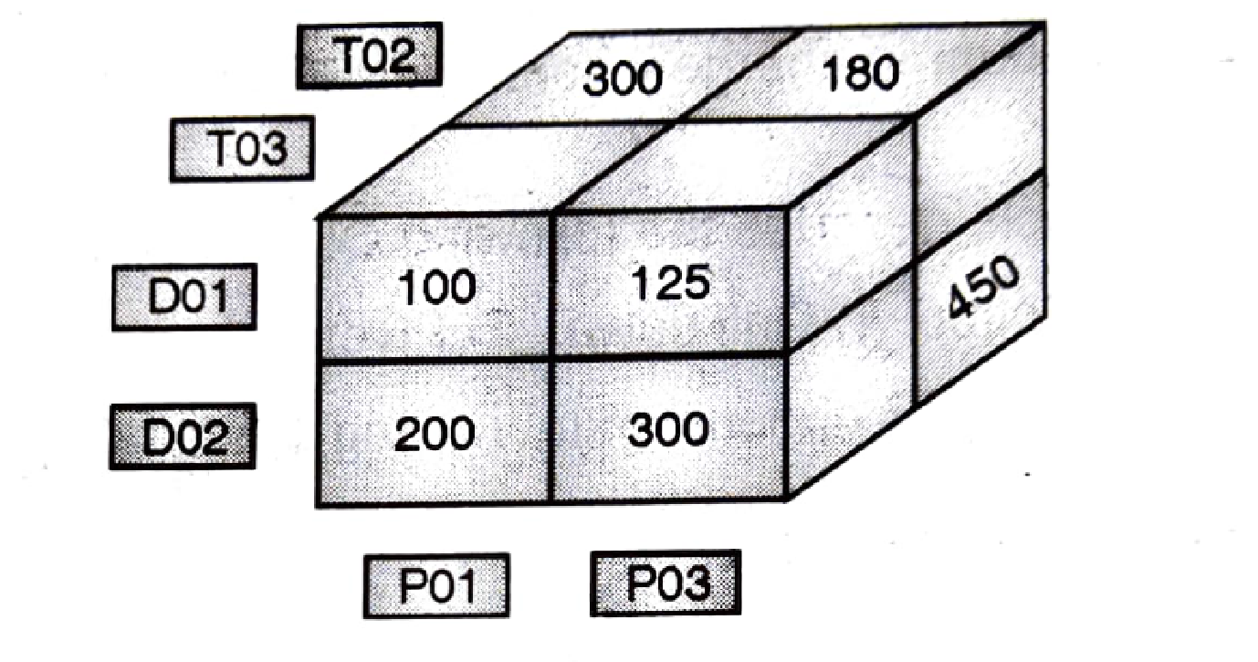

Slide 82
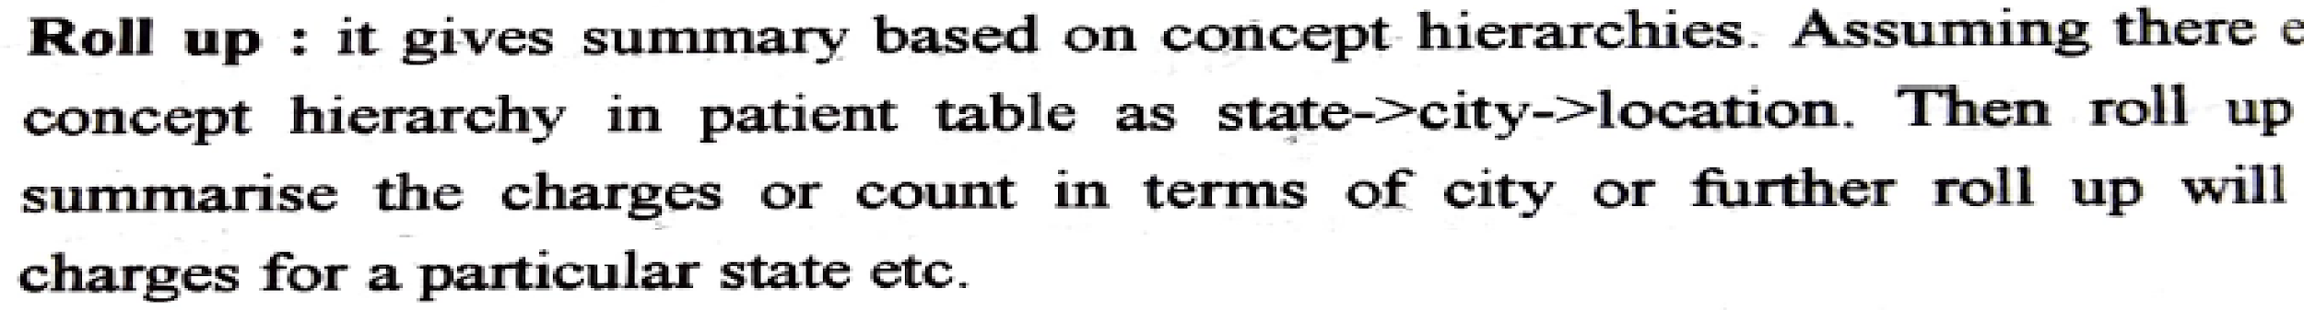
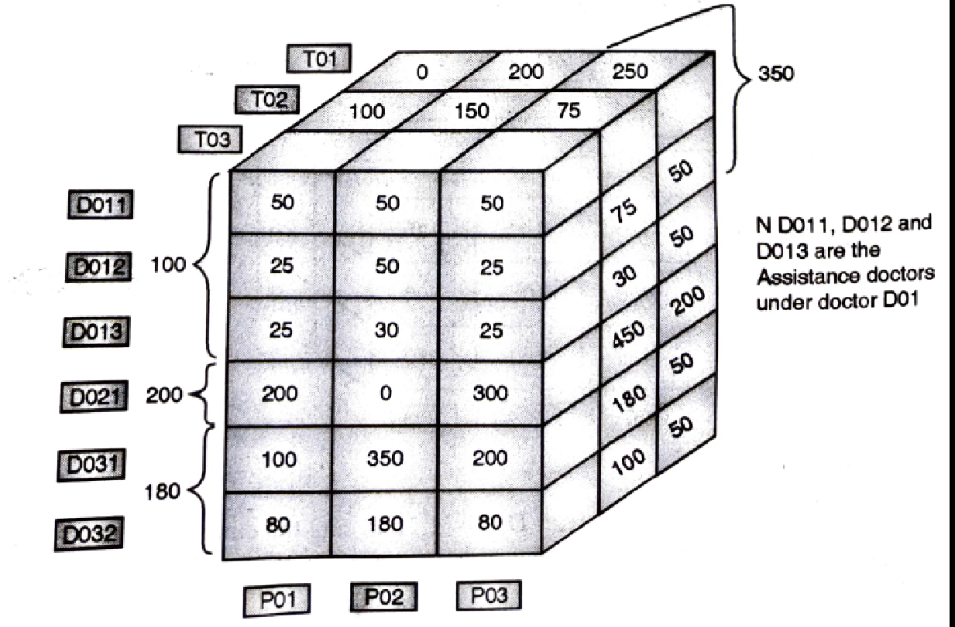

Slide 83
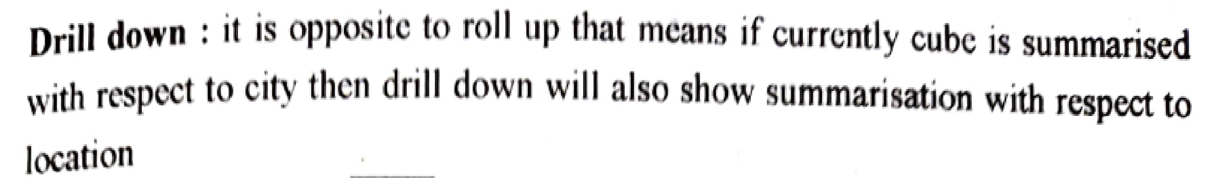
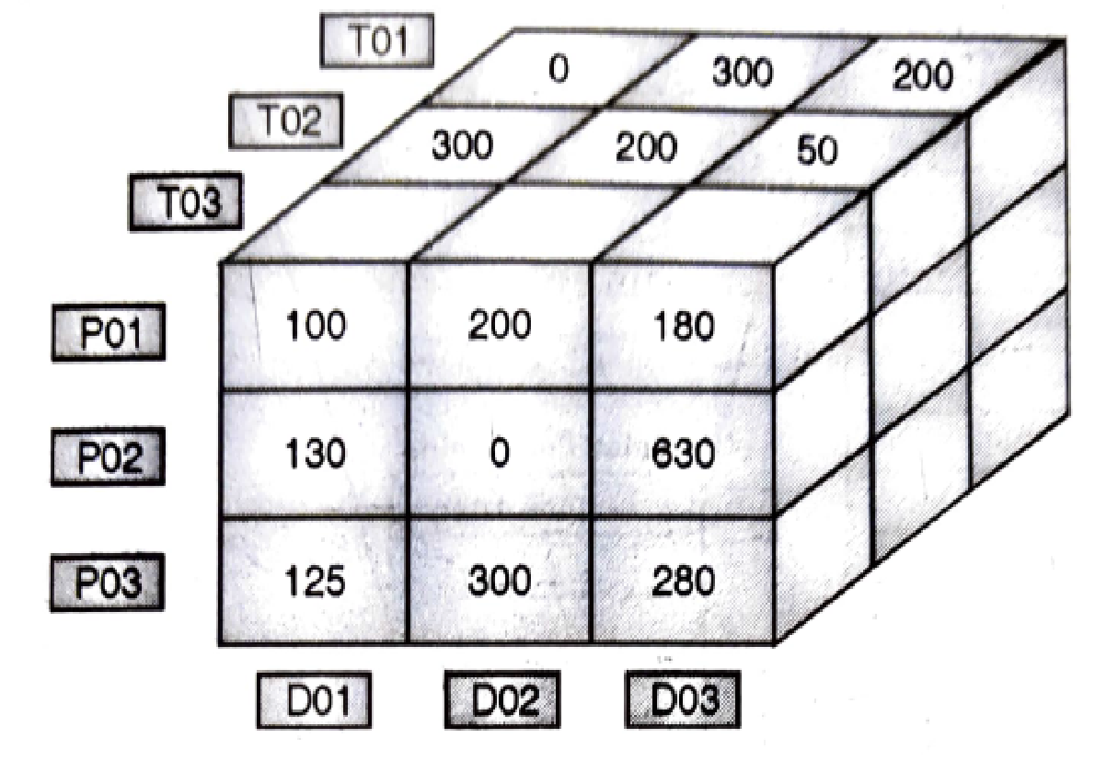

Slide 84
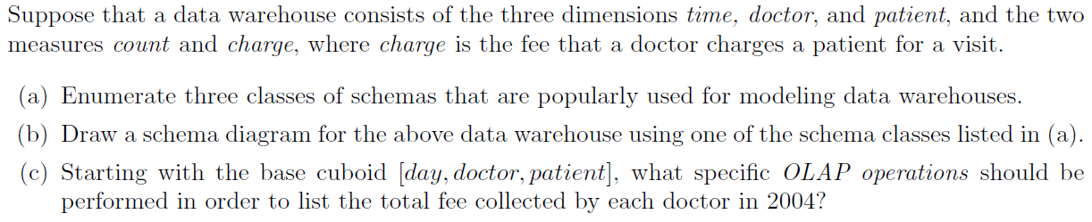

Slide 85
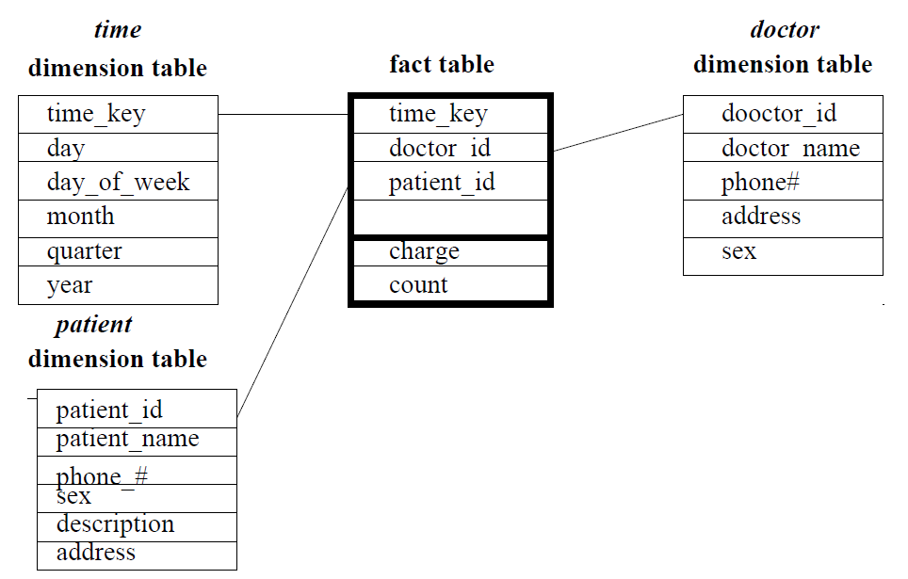
OLAP Operations to list total fees collected by each doctor in 2004
Roll Up on time from day to year
Slice on time=2004
Roll up on patient from individual to all.

Slide 86
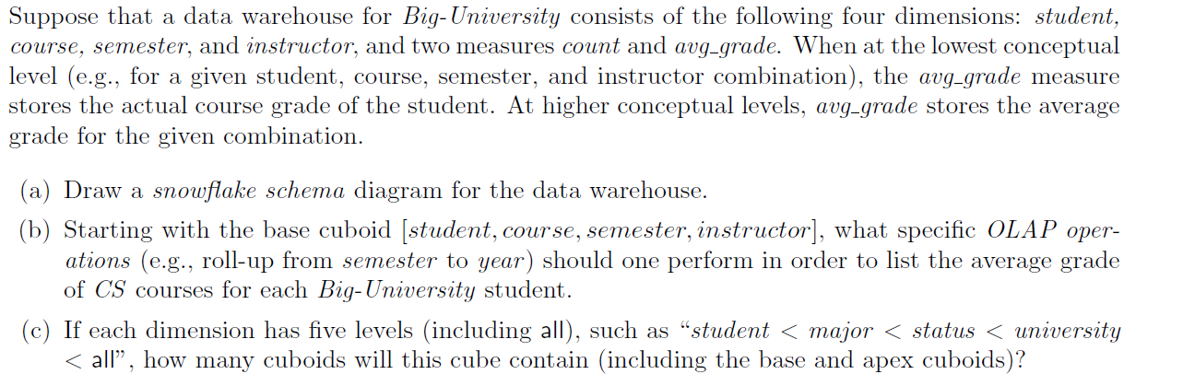

Slide 87
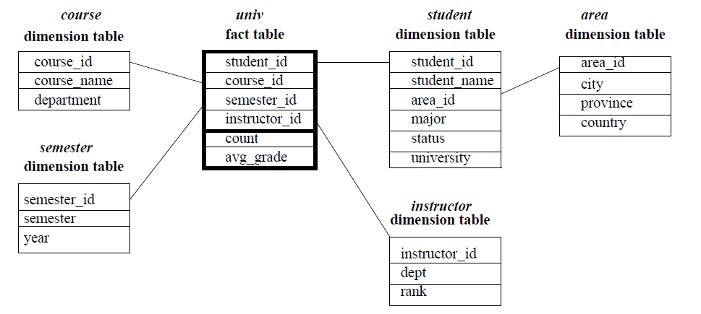
Starting with the base cuboid [student, course, semester, instructor], what specific OLAP operations (e.g., roll-up from semester to year) should one perform in order to list the average grade of CS courses for each Big-University student.
The specific OLAP operations to be performed are:
• Roll-up on course from course id to department.
• Roll-up on semester from semester id to all.
• Slice for course=“CS” .

Slide 88
(c) If each dimension has five levels (including all), such as student < major < status < university < all,
how many cuboids will this cube contain (including the base and apex cuboids)?
This cube will contain 5^4 = 625 cuboids.

Slide 89
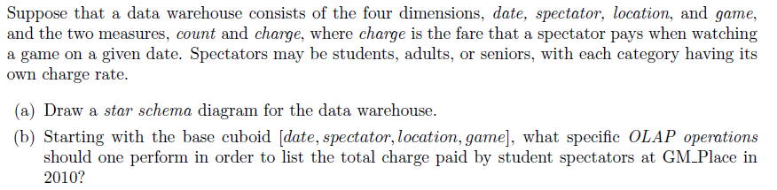

Slide 90
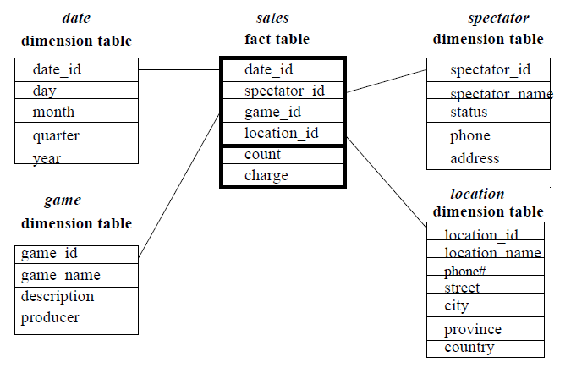
Que: Starting with the base cuboid [date, spectator, location, game], what specific OLAP operations should one perform in order to list the total charge paid by student spectators at GM Place in 2010?

Slide 91
Que: Starting with the base cuboid [date, spectator, location, game], what specific OLAP operations should one perform in order to list the total charge paid by student spectators at GM Place in 2010?
Ans:
The specific OLAP operations to be performed are:
• Roll-up on date from date id to year.
• Roll-up on game from game id to all.
• Roll-up on location from location id to location name.
• Roll-up on spectator from spectator id to status.
• Dice with status=“students”, location name=“GM Place”, and year = 2010.

